Slide 1

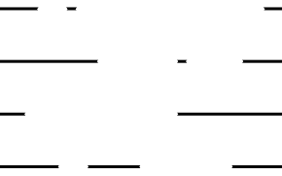


DEEP FAKE
EMERGING PROBLEM OF THIS ERA

Slide 2


Deepfakes refer to a specific type of synthetic media in which artificial intelligence (AI) and deep learning techniques are used to create or manipulate visual and audio content. The term "deepfake" is a combination of "deep learning" and "fake." Deep learning is a subset of machine learning that involves training neural networks with large amounts of data to perform specific tasks, such as image or speech recognition.
PREFACE

Slide 3

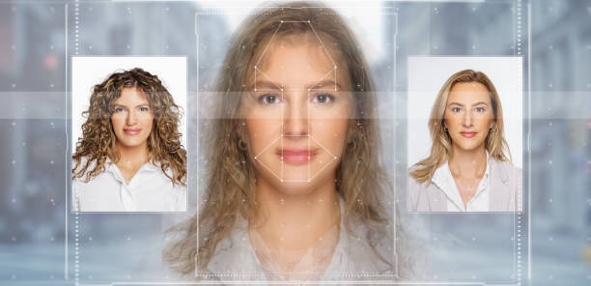
GENERATIVE MODELS:
DEEPFAKES OFTEN RELY ON GENERATIVE MODELS, SUCH AS GENERATIVE ADVERSARIAL NETWORKS (GANS) OR VARIATIONAL AUTOENCODERS (VAES). GANS, IN PARTICULAR, CONSIST OF TWO NEURAL NETWORKS – A GENERATOR AND A DISCRIMINATOR – WHICH ARE TRAINED IN OPPOSITION TO EACH OTHER.

Slide 4




TRAINING DATA:
Deepfakes require a substantial amount of training data, typically consisting of images or videos of the target individual. The model learns the facial expressions, mannerisms, and other characteristics of the subject from this dataset.

Slide 5

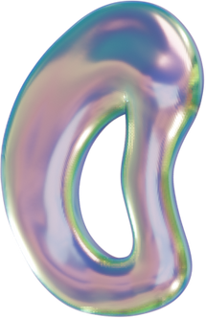
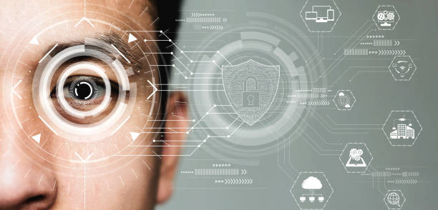


FACE MAPPING
The model uses facial landmark detection and tracking algorithms to identify key points on the face, creating a detailed map of facial features. This information is crucial for accurately superimposing one person's face onto another.

Slide 6

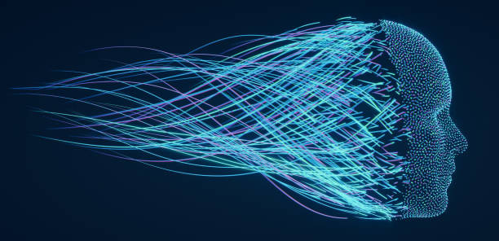
FEATURE EXTRACTION
DEEP LEARNING ALGORITHMS EXTRACT HIGH-LEVEL FEATURES FROM THE TARGET FACE, CAPTURING UNIQUE FACIAL EXPRESSIONS, EYE MOVEMENTS, AND OTHER INDIVIDUAL TRAITS. THIS ENABLES THE MODEL TO REPLICATE THESE FEATURES IN THE GENERATED CONTENT.

Slide 7
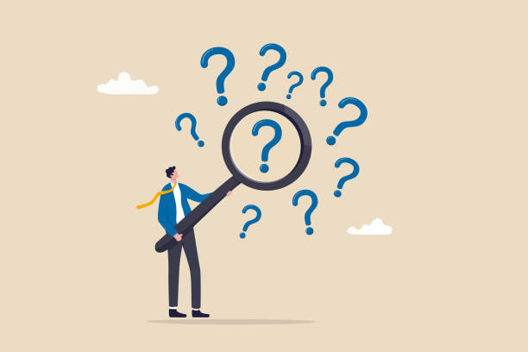
DETECTION CHALLENGES
Deepfake detection is challenging due to the sophisticated techniques used in their creation. Researchers and tech companies continually work on developing algorithms and tools to identify manipulated content, but the arms race between deepfake creators and detectors continues.

Slide 8
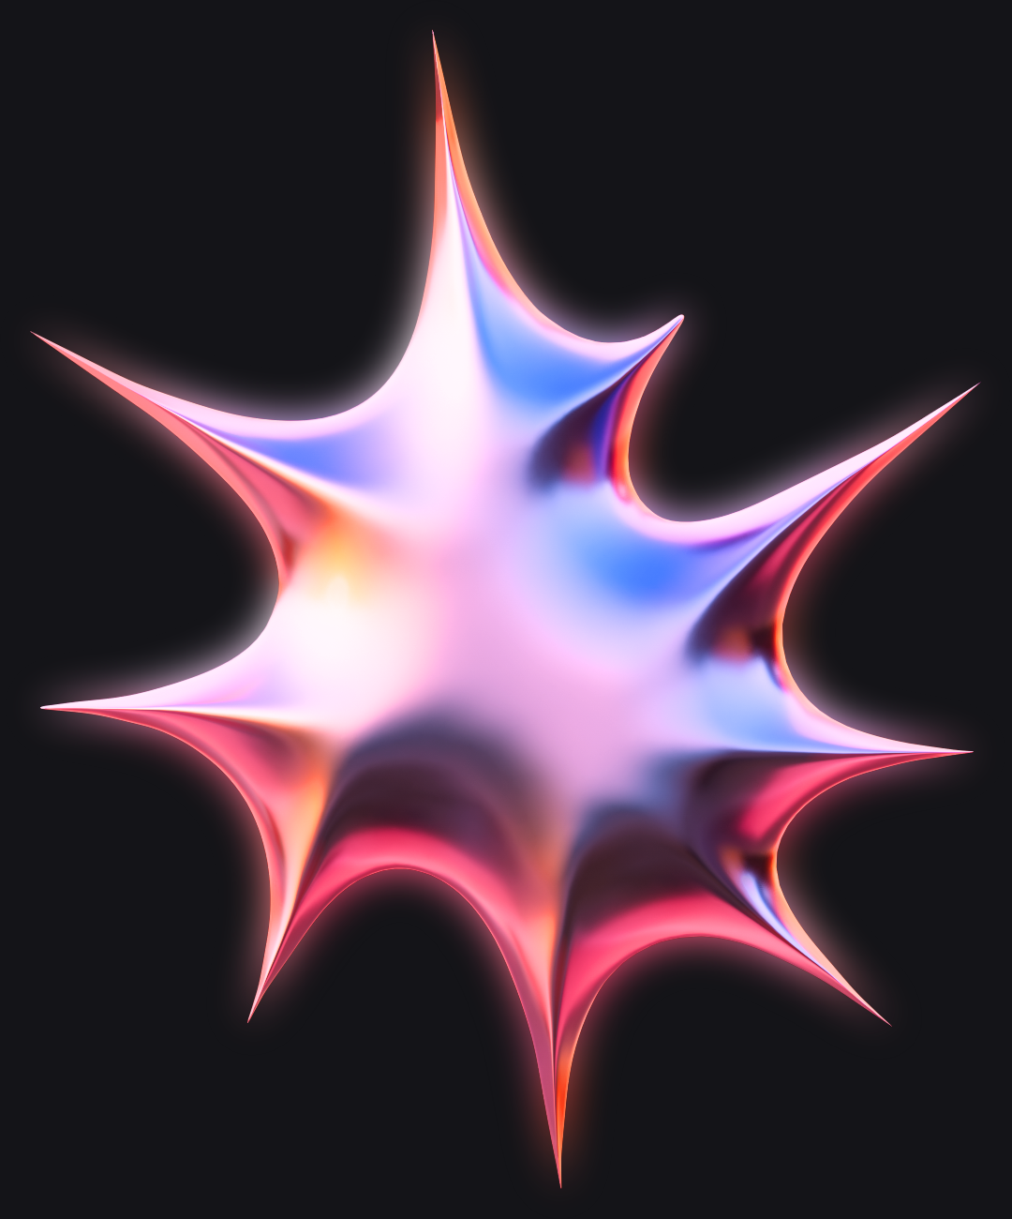
MIRAGE BREAKER
Depicting the Concept of Shattering Illusions and Exposing reality

Slide 9


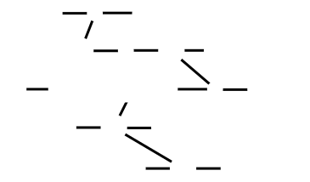
MIRAGE BREAKER IS A WEB APP THAT DETECTS DEEP FAKE VIDEOS BASED ON PATTERN RECOGNITION AND FREQUENCY ANALYSIS.

Slide 10



HIGHLIGHTS:
01
UPRISING
02
COMPATIBILITY
03
ACCURACY

Slide 11

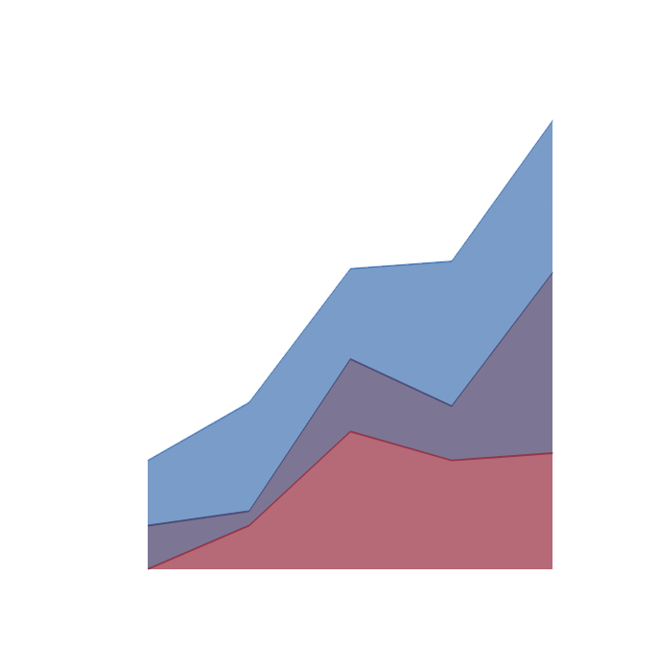

DATA ANALYSIS OF OUR APPLICATION
Our deep fake detection app has an accuracy of 99.3030%
99.3030%

Slide 12

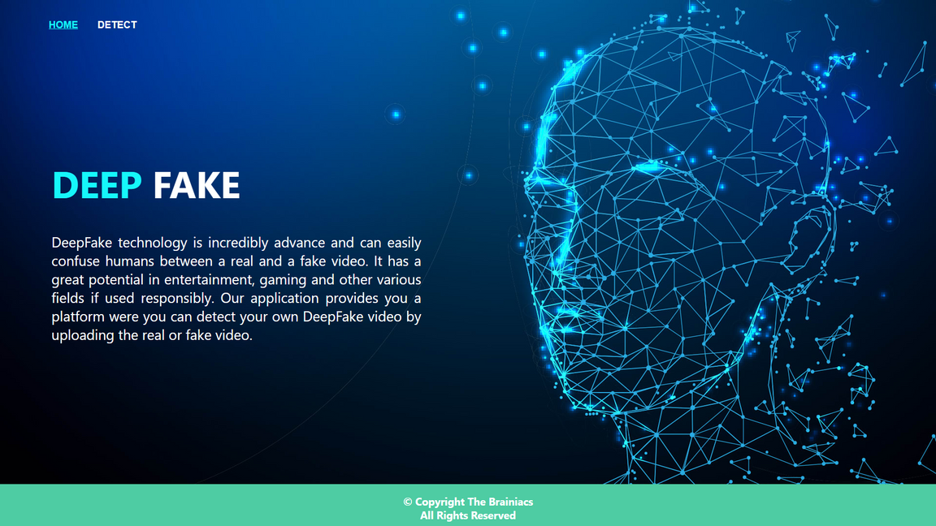
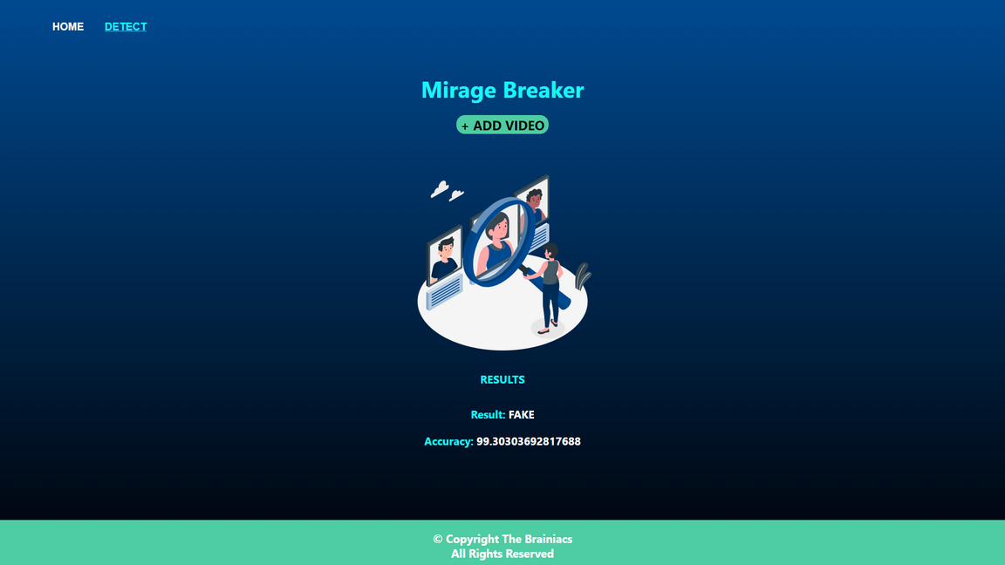

Slide 13

TECHNOLOGIES USED
01
MODEL TRAINING
FRAMEWORK
02
we used resnext and lstm for training and designing the working part of the model.
we used react for creating the front end part of the software
we used rendering flask that is a python framework

Slide 14


THANK YOU
THE BRAINIACS

